Slide 1
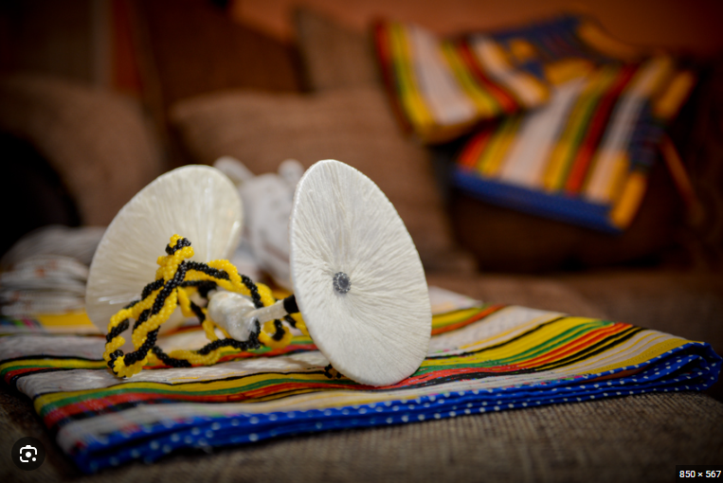
CONCEPT WORKBOOK
NWENDA
font design
by MAUmELA KHATHUTSHELO

Slide 2
table of
CONTENT
FONT DESIGN
NWENDA
VENDA CULTURE
animation
poster
DESIGN PROCESS

Slide 3
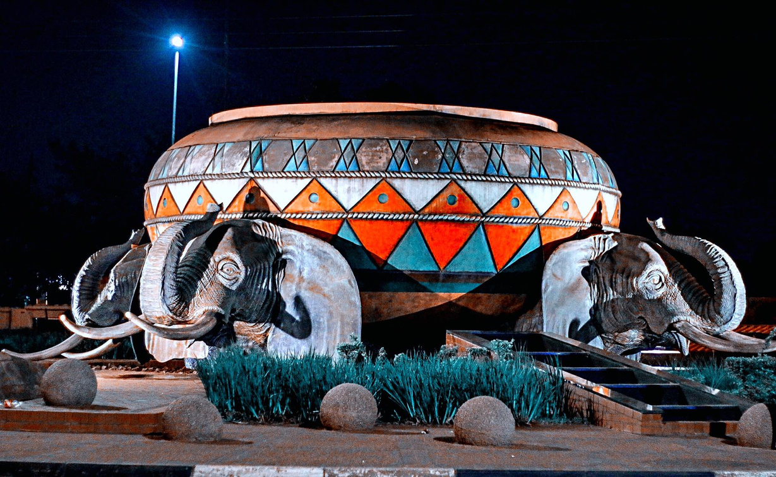
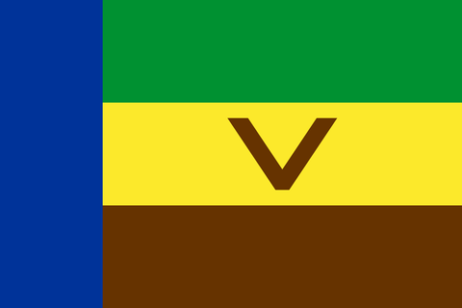
Venda
culture
VENDA
brief history
The Venḓa (VhaVenḓa or Vhangona) are a Southern African Bantu people living mostly near the South African-Zimbabwean border. The Venda language arose from interactions with Sotho-Tswana and Kalanga initiates during the 15th century in Zimbabwe.[4]
The history of the Venda starts from the Kingdom of Mapungubwe (9th Century) where King Shiriyadenga was the first king of Venda and Mapungubwe.[5] The Mapungubwe Kingdom stretched from the Soutpansberg in the south, across the Limpopo River to the Matopos in the north. The Kingdom declined from 1240, and power moved north to the Great Zimbabwe Kingdom. The first Venda settlement in the Soutpansberg was that of the legendary chief Thoho-ya-Ndou (Head of the Elephant). His royal kraal was called D’zata; its remains have been declared a National Monument. The Mapungubwe Collection is a museum collection of artefacts found at the archaeological site and is housed in the Mapungubwe Museum in Pretoria. Venda people share ancestry with Lobedu people and Kalanga people. They are also related to Sotho-Tswana peoples Sotho-Tswana and Shona groups. All these tribes were under the Venda kingdom
thohoyandou

Slide 4

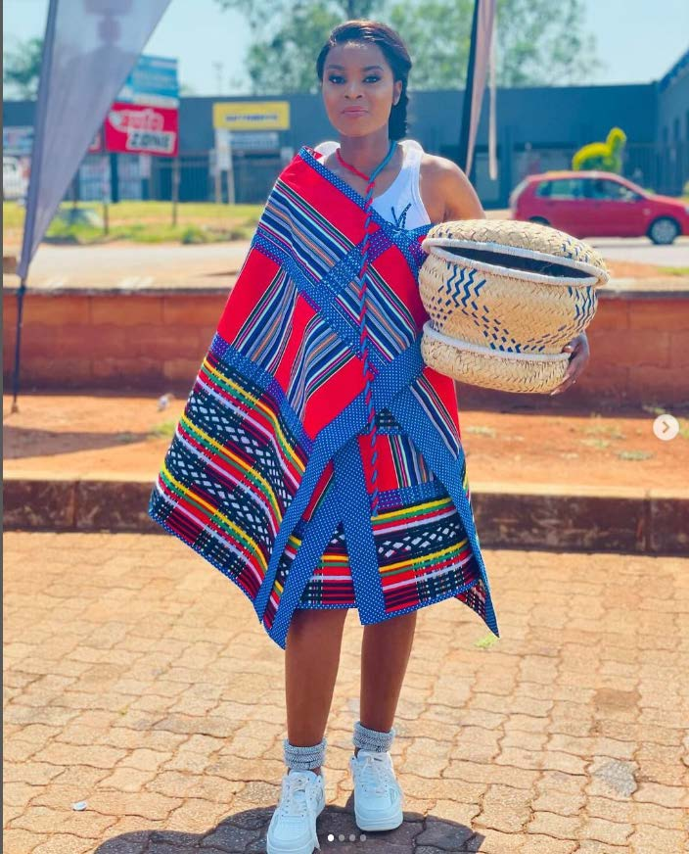
NWENDA
Origin of “nwenda”
NWENDA is a Tshivenda the traditional female attire worn from puberty to old age.Nwenda originates from way back when Vhavenḓa women used to wear rectangular pieces of skin, usually made out of cowhide which they used to call muenda. One piece of the muenda skin used to be wrapped around the hips, while the other one was wrapped around the shoulders. However, when colonial white settlers arrived in the shores occupied by Vhavenḓa they then introduced the fabric, the fabric which then replaced the cowhide.
Nwenda is made of a double rectangular piece of fabric, mostly the salempo fabric.It has become fashionable to wear miňwenda, made of linen. This miňwenda may consists of two pieces, the top and bottom parts. The top part has strips of fabric, used to tie it over the shoulder or over the chest called pfunelo. The bottom ňwenda has no pfunelo, but is tucked around the waist and secured by a piece of fabric, almost in the shape of a belt.

Slide 5
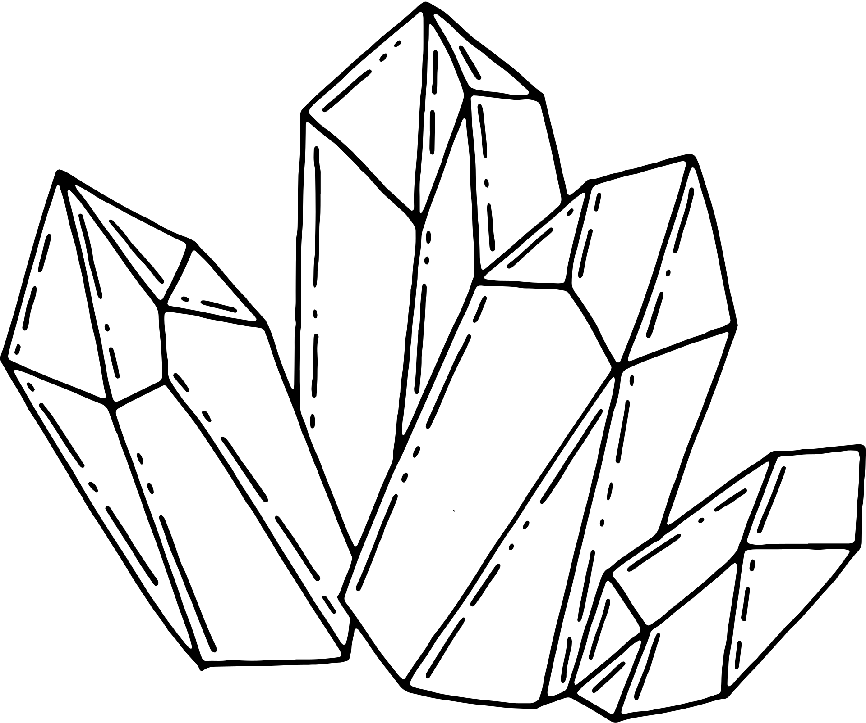
Font
specification
DESIGN
I wanted the following outlook for my font design:
Simple, modern
Vhavenda colours
Traditional theme
Pattern
Clean
Geometric sans-serif
Font-a set of printable or displayable typography or text characters in a specific style and size.
Design-a plan or drawing produced to show the look and function or workings of a building, garment, or other object before it is made.
why?
I chose to design with heritage theme, mainly for few reasons:
In celebration of heritage month-September
16th of September was Venda independence day
It was the one topic i could relate to-My culture
Nwali/Raluvhimba-Who vhavenda believed was a universal god and that he was the only creator of mankind was rumored to visit Venda during this month.

Slide 6
NWENDA
Types and significance
Lambamuklaha
Tshakhuma na ndilani
Thukhulathambo
The name is derived from a combination of the verb—lamba (“to reject”) and the noun mukalaha (“old man”). The lambamukalaha is a ňwenda worn by young women of childbearing age. When such a young woman wears this type of ňwenda, the act of wearing becomes a cultural statement or declaration that she is not willing to entertain any amorous advances from elderly men. In this way, she tacitly declares that she has taken good care of herself, and is groomed well enough only to consider a romantic liaison with suitors of a comparable age.
The direct English transliteration of Tshakhuma na nḓilani is “en route to Tshakhuma and anywhere along the way to Tshakhuma.” This name suggests that while Tshakhuma is the ultimate destination, anyone who goes to any other place before the final destination is welcome on board. Tshakhuma na nḓilani has become quotidian parlance, used by taxi-drivers as they shout out to alert potential passengers of their destination.In the context of ňwenda, a garment worn by women, the statement assumes sexual undertones, signifying the loose moral character of the wearer. Accordantly, this ňwenda is known to be the preferred attire for prostitutes.
The word derives from the verb ṱhukhula (“to cut off”) and the noun thambo (“string or a rope”). This type of ňwenda is reputed to have been so pretty that it became the object of serious admiration by scores of young women. The admiration became an obsession to a point where those who could not get it as their own felt a deep sense of loss and became depressed. Legend has it that this led to the young women opting to attempt suicide. The ňwenda derives its nomenclature from being associated with the act of cutting off the rope by individuals who rescue the young woman from suicide.

Slide 7
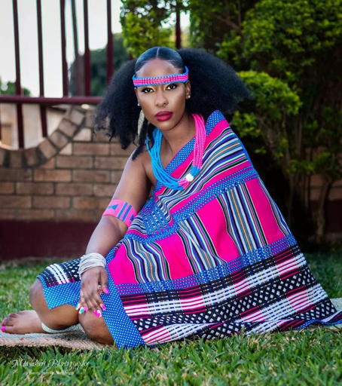
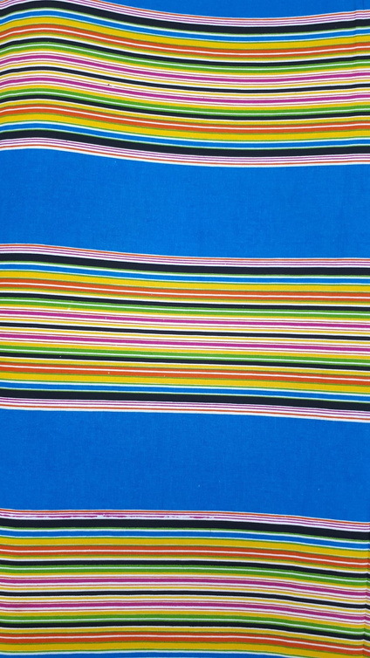
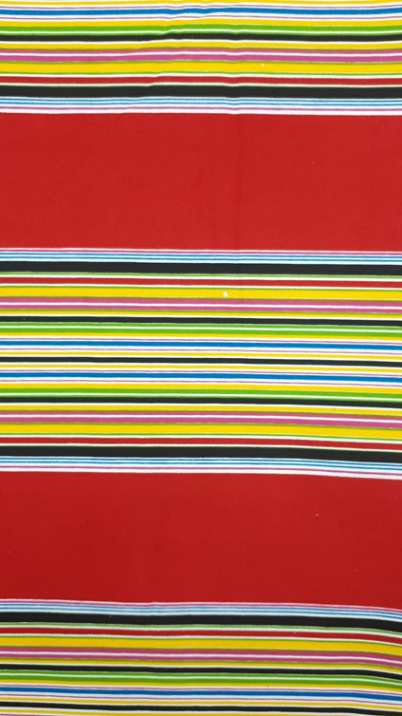
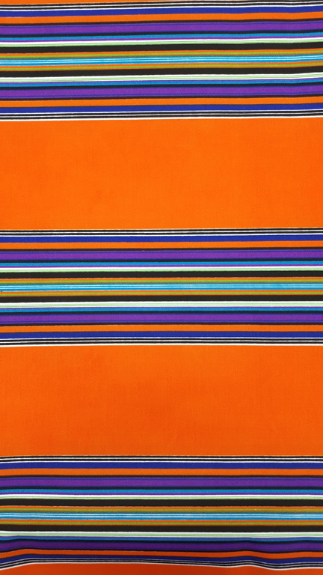
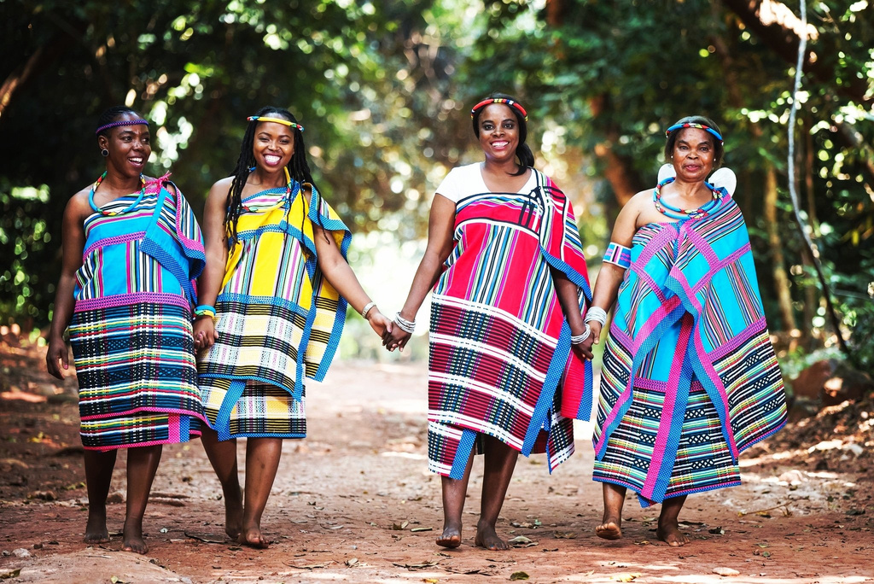
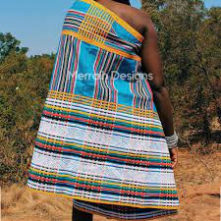
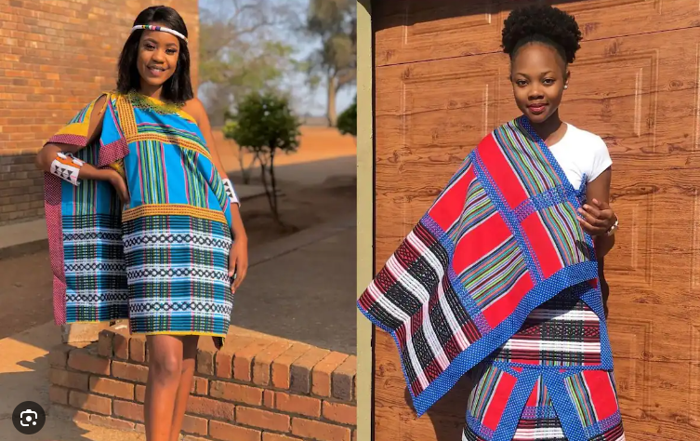
Mood
Board

Slide 8
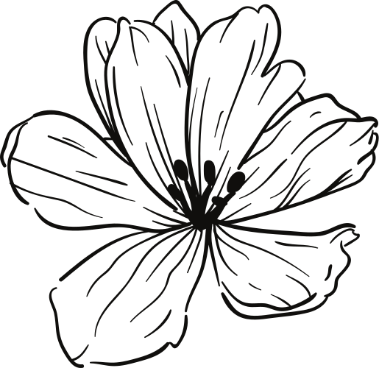
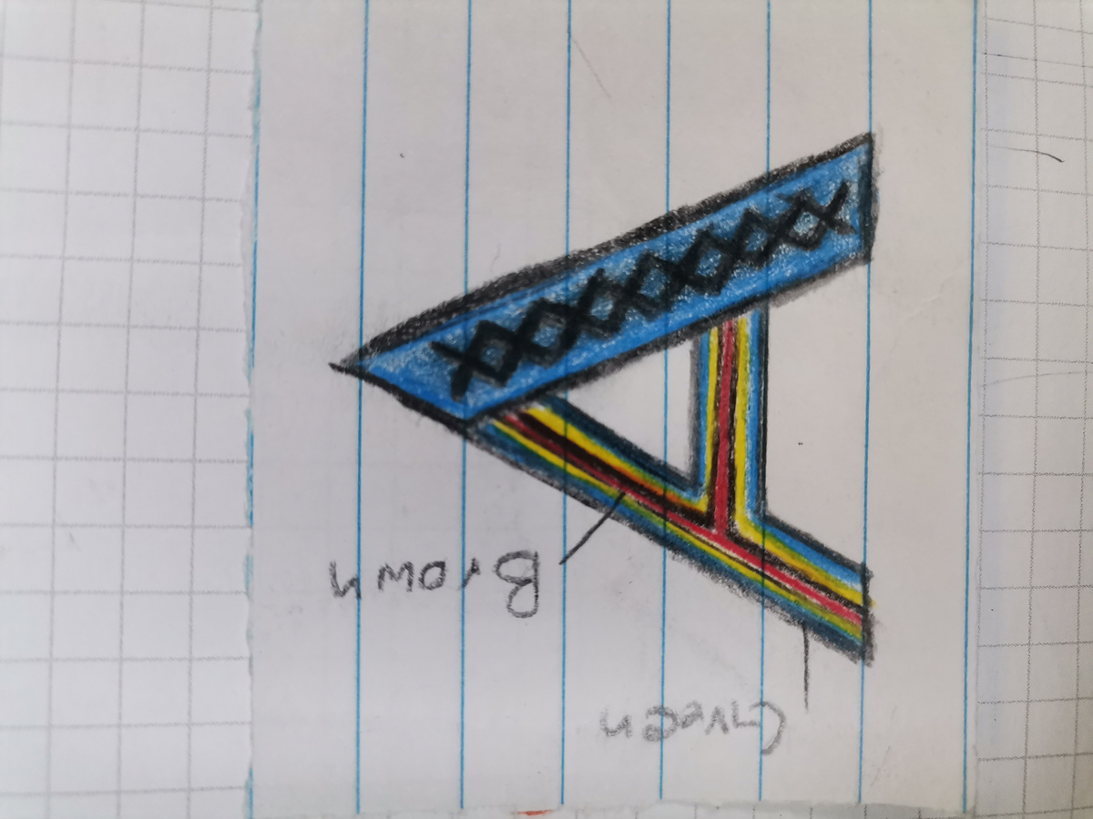
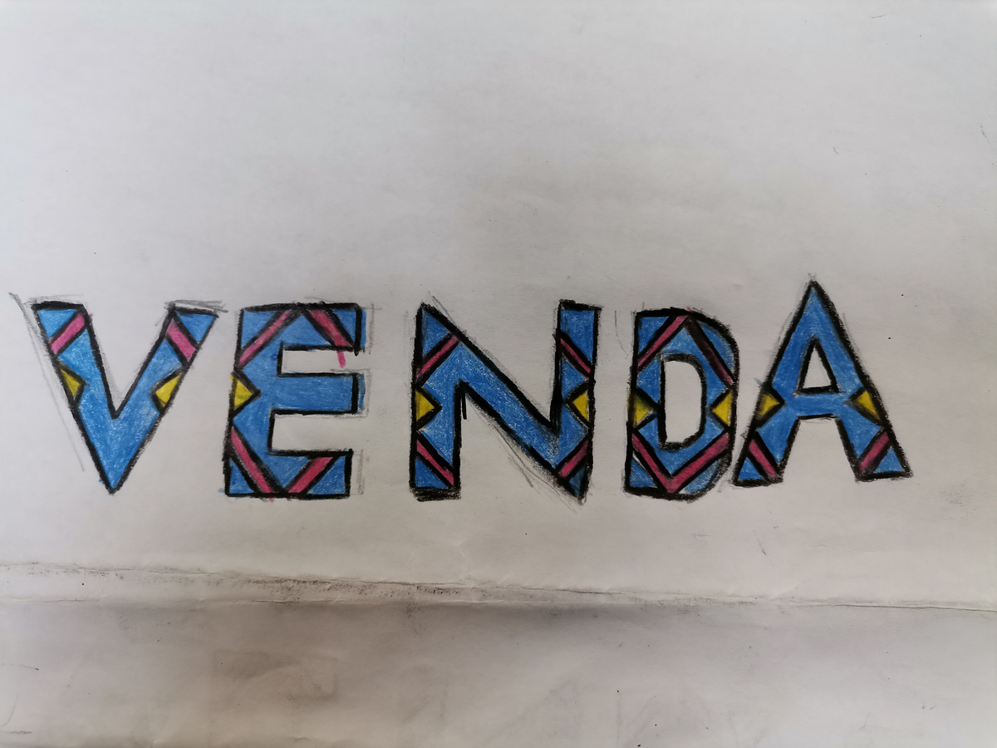
Design
process
Design
CONCEPT

Slide 9
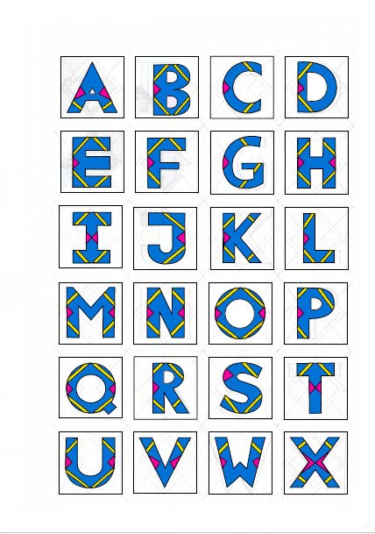
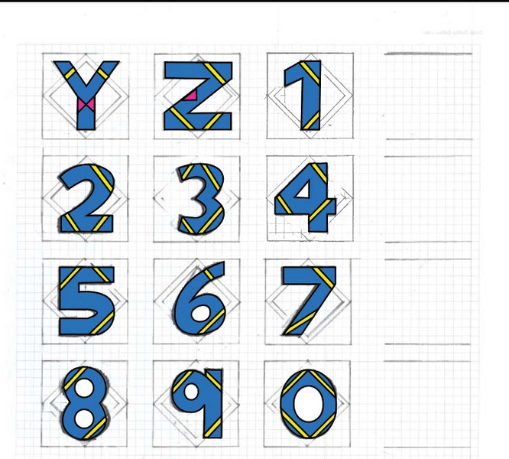
Final Design
font

Slide 10
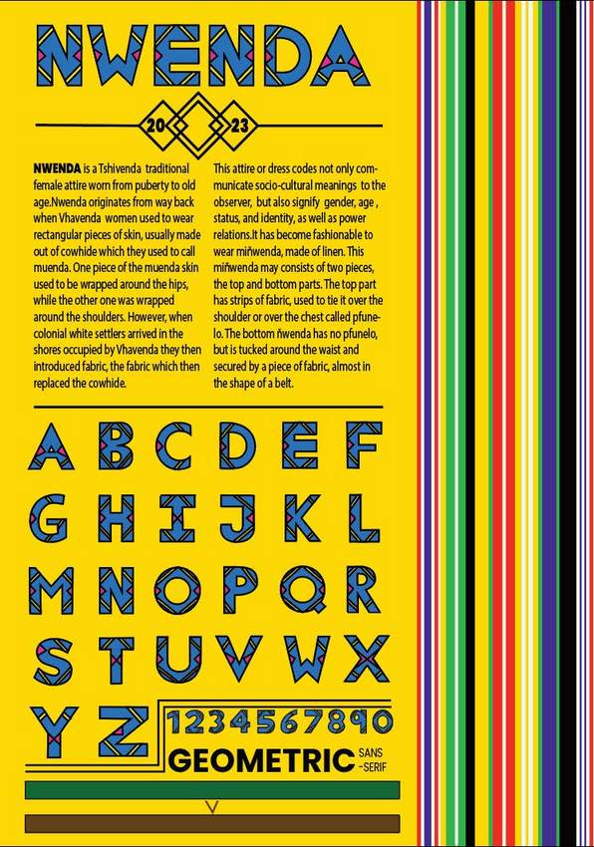
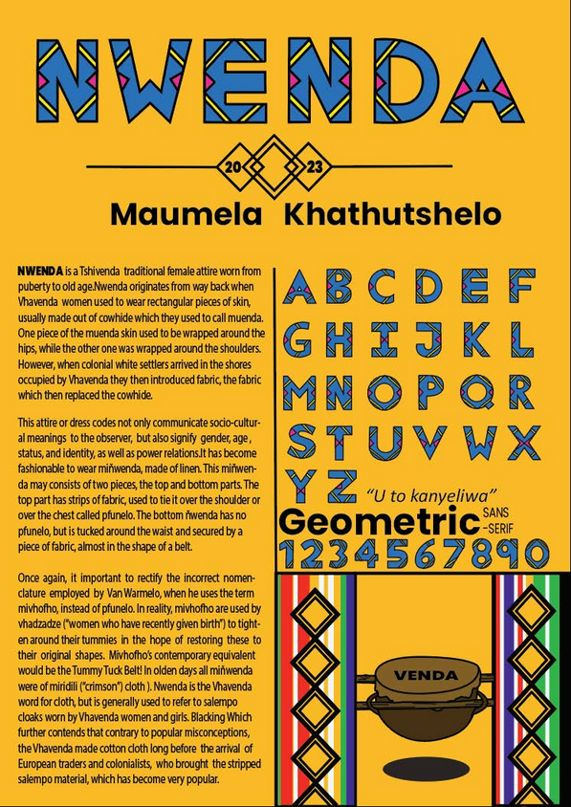
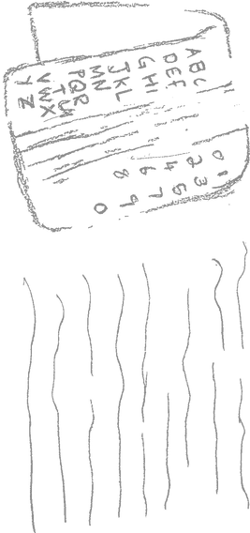
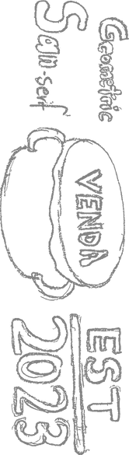
POSTER
concept & Design

Slide 11
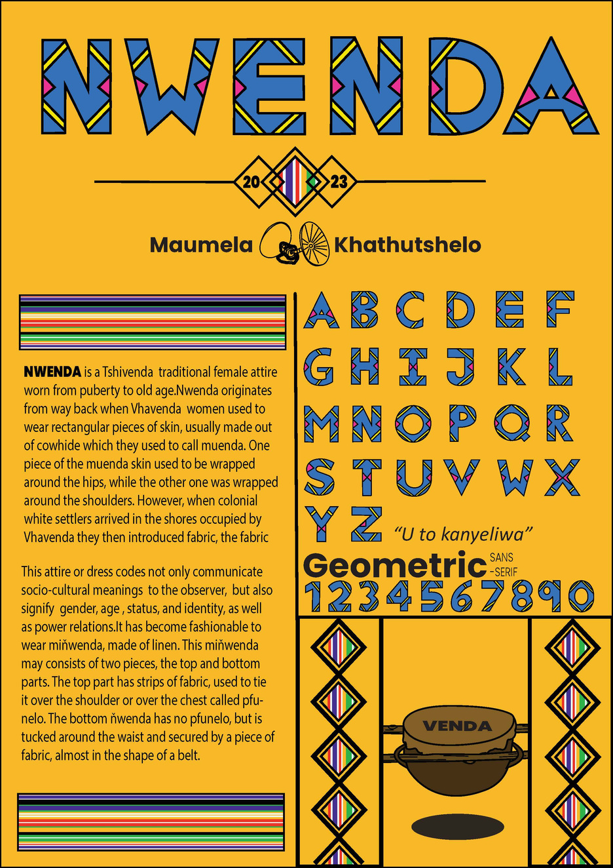
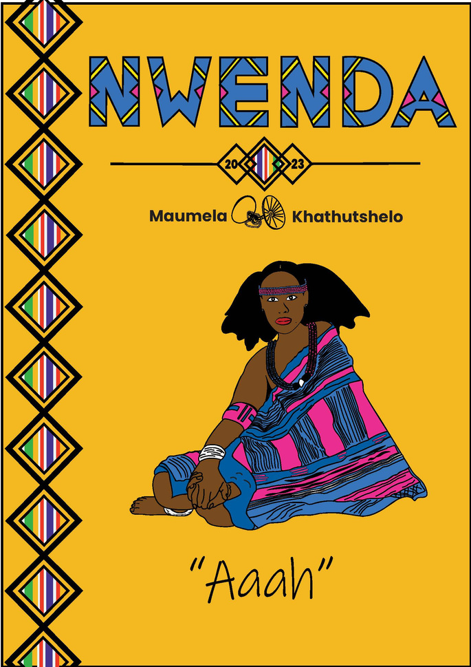
Final
POSTER DESIGN

Slide 12
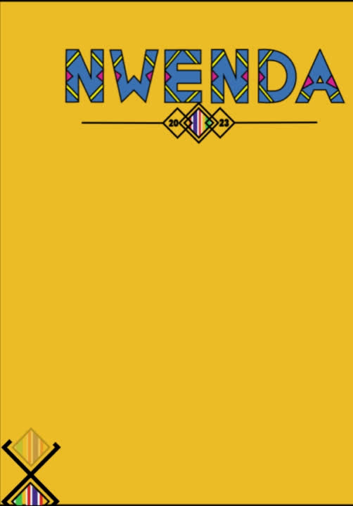
Animation
After doing the design for the alphabet font and the typography poster,I decided to create an animated infographic video of the poster.Which i then created from scratch,also using some elements from the initial typography poster.
Enjoy..........

